Slide 1
Logistic Regression
Amal Joseph
Machine Learning Engineer @ Arcesium

Slide 2
Overview
Logistic Regression
Applications of Logistic Regressions
Connecting Logistic Regression and Linear Regression together
Hands-on

Slide 3
Logistic Regression
Logistic regression is one of the most common machine learning algorithms used for binary classification.
It is a special case of linear regression as it predicts the probabilities of outcome using log function.

Slide 4


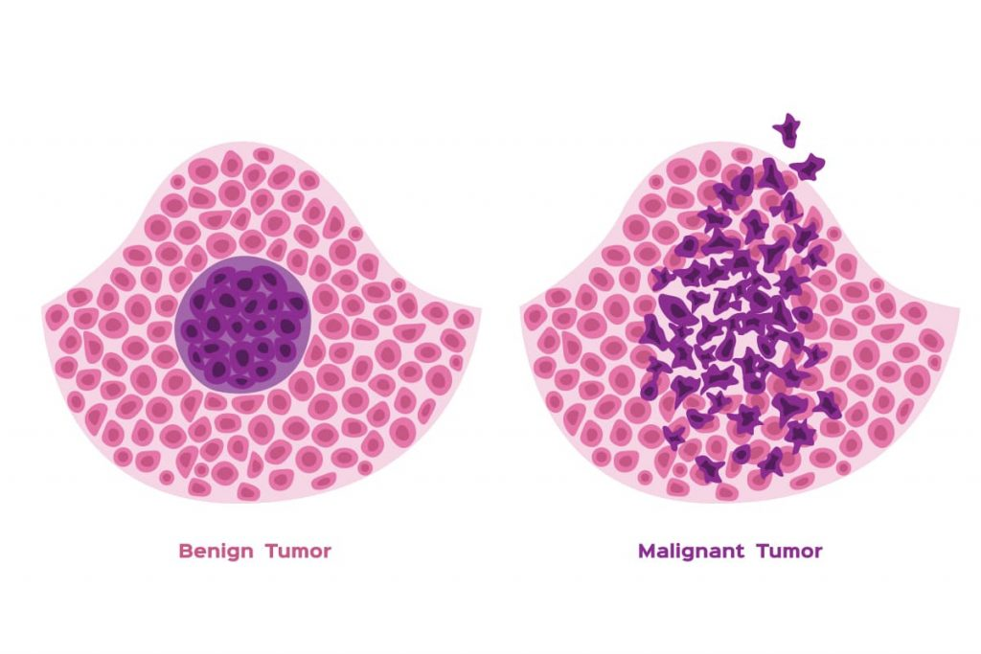
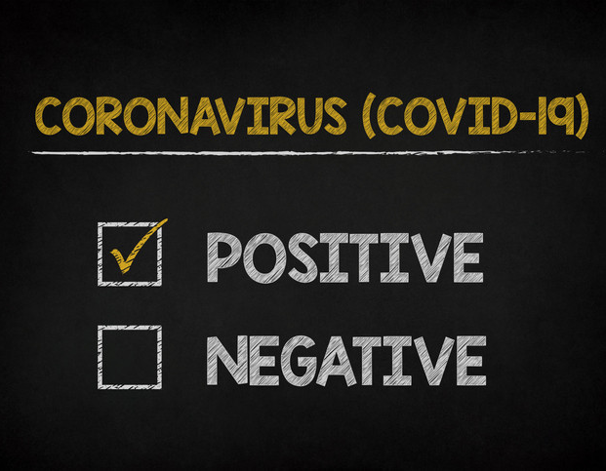
Logistic Regression
Logistic regression is one of the most common machine learning algorithms used for binary classification.
It is a special case of linear regression as it predicts the probabilities of outcome using log function.

Slide 5
Cancer Classification
Cancer Detected
Cancer Not Detected
Tumor Size

Slide 6
Cancer Classification
Our goal is to predict which class a particular tumor belongs to.
1 - if the cancer is detected
2 - if the cancer is not detected
Cancer Detected
1
1 represent the positive class / true class
0 represent the negative class / false class
0
Cancer Not Detected
Tumor Size

Slide 7
Cancer Classification
We can try to draw a curve that better represent this data.
(instead of fitting a regression line)
Cancer Detected
1
1 represent the positive class / true class
0 represent the negative class / false class
0
Cancer Not Detected
Tumor Size

Slide 8
Cancer Classification
This S shaped curve is called the logistic function or the sigmoid function.
Cancer Detected
1
0
Cancer Not Detected
Tumor Size

Slide 9
Cancer Classification
This S shaped curve is called the logistic function or the sigmoid function.
And the logistic function gives us the probability of having cancer.
Cancer Detected
1
0
Cancer Not Detected
Tumor Size

Slide 10
Cancer Classification
This S shaped curve is called the logistic function or the sigmoid function.
And the logistic function gives us the probability of having cancer.
Cancer Detected
1
0
Cancer Not Detected
Tumor Size

Slide 11
Cancer Classification
This S shaped curve is called the logistic function or the sigmoid function.
And the logistic function gives us the probability (P) of having cancer.
Cancer Detected
1
P
0
Cancer Not Detected
Tumor Size

Slide 12
Cancer Classification
This S shaped curve is called the logistic function or the sigmoid function.
And the logistic function gives us the probability (P) of having cancer.
If P > 0.5, then Cancer Detected
If P < 0.5, then Cancer Not detected.
Cancer Detected
1
P
0.5
0
Cancer Not Detected
Tumor Size

Slide 13
Cancer Classification
Here P > 0.5, that data point is classified as Cancer Detected.
Cancer Detected
1
P
0.5
0
Cancer Not Detected
Tumor Size

Slide 14

Cancer Classification
Sigmoid/ Logistic Function
Cancer Detected
y
1
y
0.5
0
Cancer Not Detected
Tumor Size

Slide 15
Cancer Classification
Sigmoid/ Logistic Function
Cancer Detected
y
1
y
y = mx + c
0.5
0
Cancer Not Detected
Tumor Size

Slide 16
Cancer Classification
Sigmoid/ Logistic Function
Cancer Detected
y
1
y
y = mx + c
Does this looks like a Linear Regression line?
0.5
0
Cancer Not Detected
Tumor Size

Slide 17
Cancer Classification
Sigmoid/ Logistic Function
Cancer Detected
y
1
y
y = mx + c
Does this looks like a Linear Regression line?
0.5
0
Cancer Not Detected
Tumor Size

Slide 18
Cancer Classification
Sigmoid/ Logistic Function
Cancer Detected
y
1
y
y = mx + c
Does this looks like a Linear Regression line?
0.5
0
Cancer Not Detected
y
mx +c
Tumor Size

Slide 19
Cancer Classification
Sigmoid/ Logistic Function
Cancer Detected
y
1
y
y = mx + c
Does this looks like a Linear Regression line?
0.5
0
Cancer Not Detected
y
mx +c
Tumor Size

Slide 20
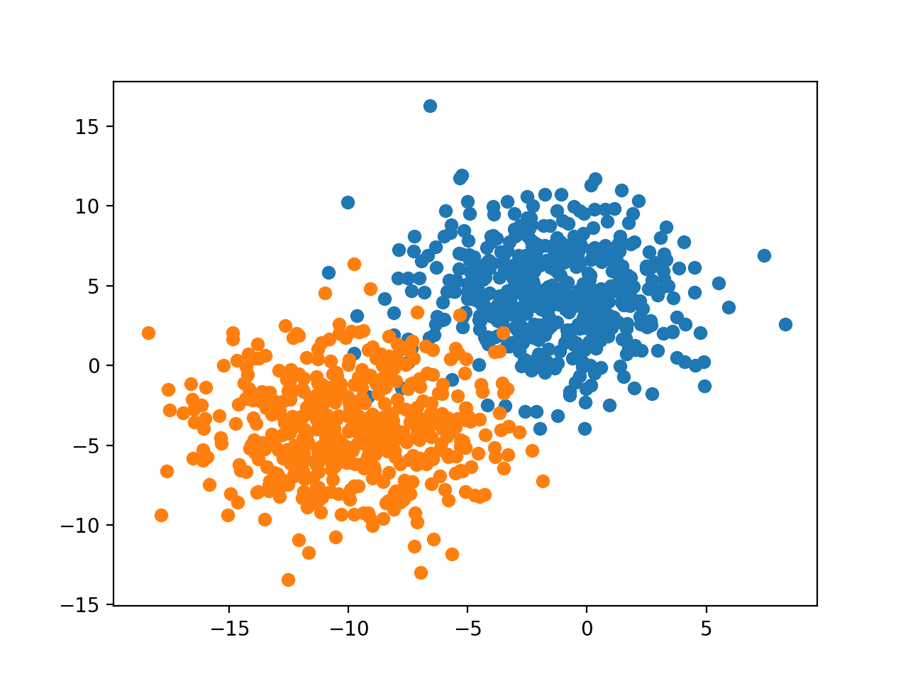
Let’s see Logistic Regression in Action!

Slide 21
We could start drawing a decision boundary to separate these two classes.

Slide 22
We could start drawing a decision boundary to separate these two classes.

Slide 23
We could start drawing a decision boundary to separate these two classes.

Slide 24
We could start drawing a decision boundary to separate these two classes.

Slide 25
We could start drawing a decision boundary to separate these two classes.

Slide 26
This is the best line we could draw to separate these two classes.

Slide 28
Time for Hands On
Download dataset from bit.ly/day6_dataset
Get Colab notebook from bit.ly/day6_notebook

Slide 29
Please give your feedback
bit.ly/day7_feedback

Slide 30

Connect with us on Instagram
instagram.com/tbh.ind

